Slide 1
Keyboard and Mouse Actions

Slide 2
What is Actions class in Selenium?
Actions class is a collection of individual Action that you want to perform. For e.g. we may want to perform a mouse click on an element. In this case we are looking at two different Action
Moving the mouse pointer to the element
Clicking on the element

Slide 3
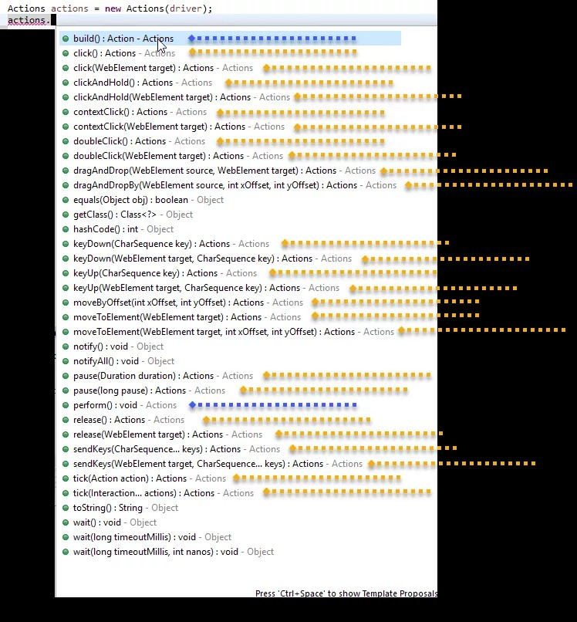
There is a huge collection of methods available in Actions class. The below screenshot shows the list of methods available

Slide 4
How to Use Actions class in Selenium?
Import package (import org.openqa.selenium.interactions.Actions;)
Instantiate Actions class
Generate actions sequence
Build the actions sequence
Perform actions sequence

Slide 5
Methods in Actions class of Selenium
There are a lot of methods in this class which can be categorized into two main categories:
- Keyboard Events
- Mouse Events

Slide 6
Different Methods for performing Keyboard Events
keyDown(modifier key): Performs a modifier key press.
sendKeys(keys to send ): Sends keys to the active web element.
keyUp(modifier key): Performs a modifier key release.

Slide 7
Different Methods for performing Mouse Events
click(): Clicks at the current mouse location.
doubleClick(): Performs a double-click at the current mouse location.
contextClick() : Performs a context-click at middle of the given element.
clickAndHold(): Clicks (without releasing) in the middle of the given element.
dragAndDrop(source, target): Click-and-hold at the location of the source element,
moves to the location of the target element
dragAndDropBy(source, xOffset, yOffset): Click-and-hold at the location of the source
element, moves by a given offset
7. moveToElement(toElement): Moves the mouse to the middle of the element
8. release(): Releases the depressed left mouse button at the current mouse location

